Slide 1
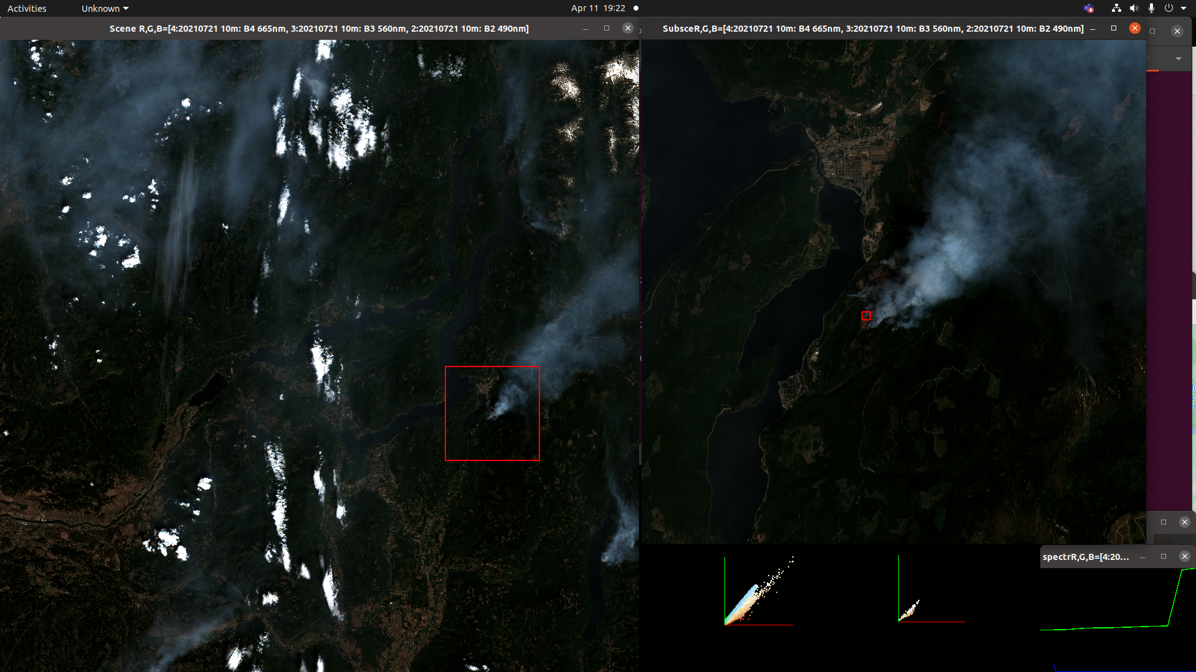
Fire mapping w Shortwave Infrared
BC Gov RS CoP 2022 Apr 13, 11:30
Ash Richardson, Predictive Services Unit

Slide 2

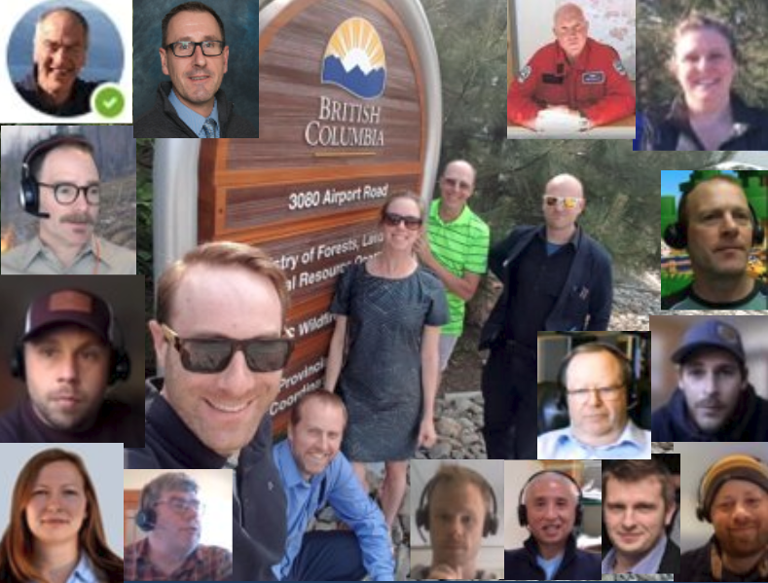


Overview
Pre-process
Fire Detection method #1
And Perimeter recipe
Fire Detection method #2
Deal w clouds/ice without Level2-processing cloud mask!
Appendix:
Visualize results of Sen2Cor

Slide 3
Satellite mapping of fires
Remote areas: less costly, safer compared to heli-GPS perimeters
Cost effective, timely BI for fires being monitored
Fire growth modelling & other predictive services require daily perimeter updates to reduce simulation error
Complement other methods: airborne-GPS and IR scanning (less frequent as fires get large/ smoke conditions limit visibility)
Provide additional info about recent fire activity along a perimeter, helping refine model inputs
Start with Sentinel-2.. Add more?

Slide 4
SWIR for fire mapping?
"Unlike TIR imaging, smoke is not transparent at these wavelengths but SWIR has somewhat better haze and smoke penetration than visible light" [1]
Historically SWIR more popular for monitoring volcanoes than forest fires.. (DGG)
Increasing popularity of SWIR for forest fires
Connected with / enhanced by Machine Learning algorithms [3]
[1] (2016) R.S Allison, J. M. Johnston, G Craig and S. Jennings, "Airborne Optical and Thermal Remote Sensing for Wildfire Detection and Monitoring
[2] (2004) Vis with fires = orange / red https://www.youtube.com/watch?v=lp1fj2Vx6fY
[3] (2021) Automated classification of heat sources detected using SWIR remote sensing
https://www.sciencedirect.com/science/article/pii/S0303243421001987

Slide 5
Pre-processing steps
Sen2cor processing (L1C --> L2A)*
Retain
B12 2190nm (20m), B11 1610nm (20m), B9 945nm (60m)
Resample to 20m
(Why? bands of interest: 20m, 20m, 60m)
Sort bands in order: wavelength increasing**
** Always sort data if:
We can
It makes physical sense to do so
Why?
Easier to follow the story
Sorting is the only thing computers can do (proof by "SUBLEQ" OISC)
*Still need this for now. Also might want to bring the B10 back!

Slide 6
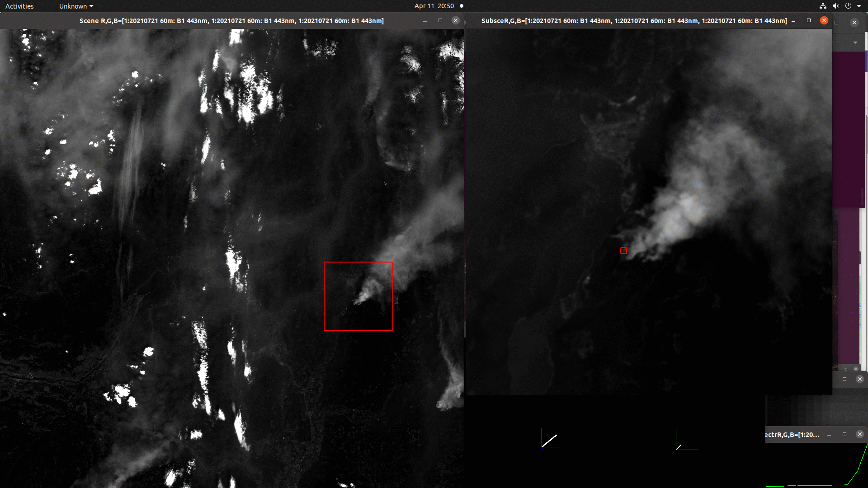
Processing steps
Individual bands (increasing)

Slide 7

Satellite-based fire perimeter recipe
Threshold (create a fire mask)
Flood (identify pieces of fire)
Link (put pieces together)
Trace (a linear boundary)
Exclude segments less than certain size
Alpha hull --> geolocate the coords
Create KML

Slide 8
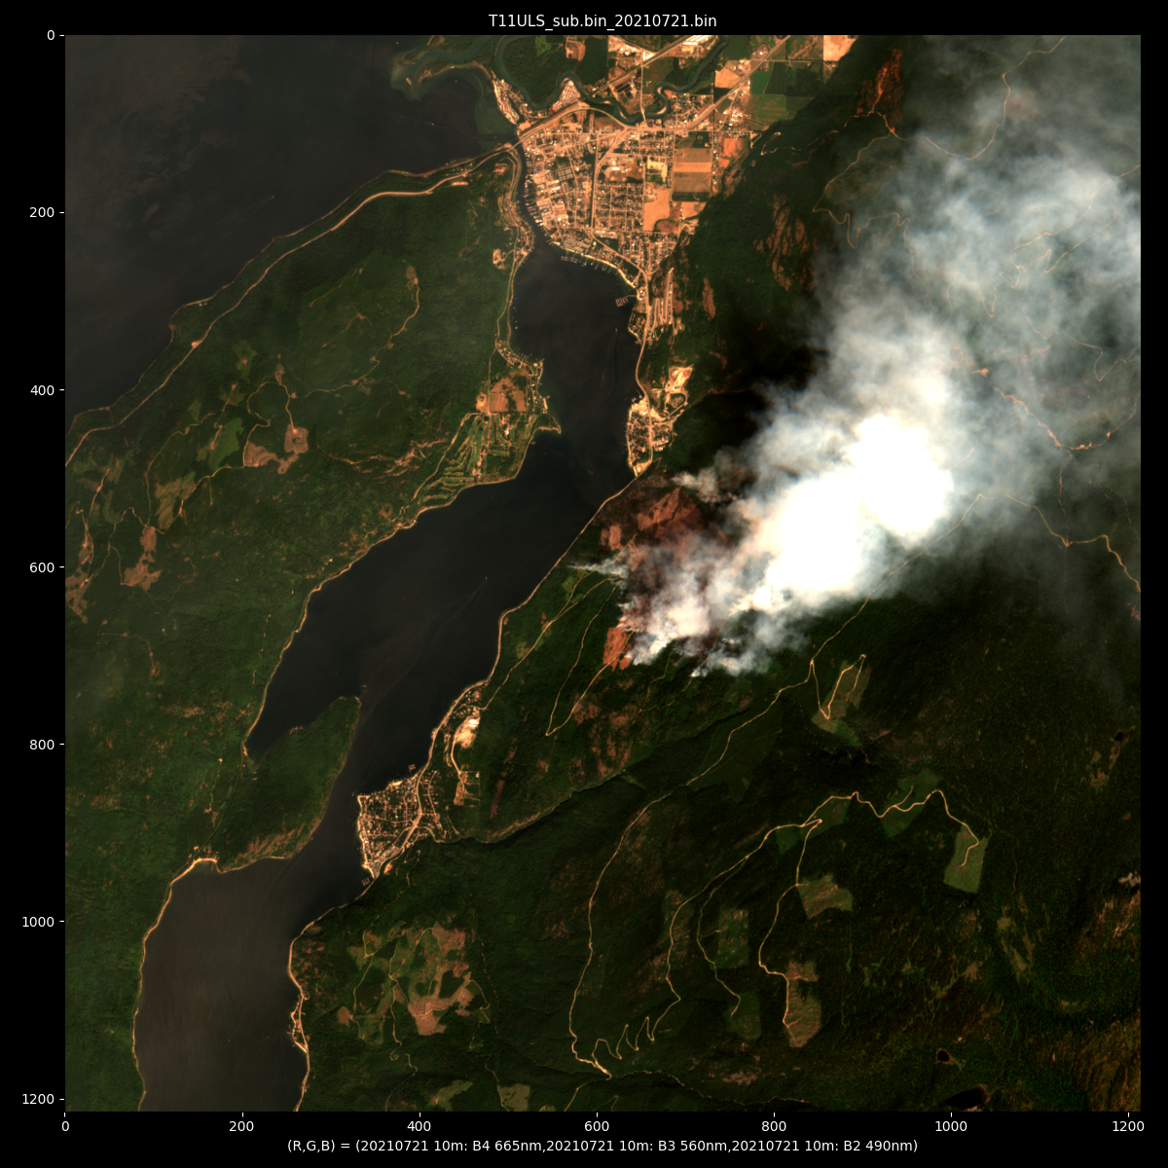
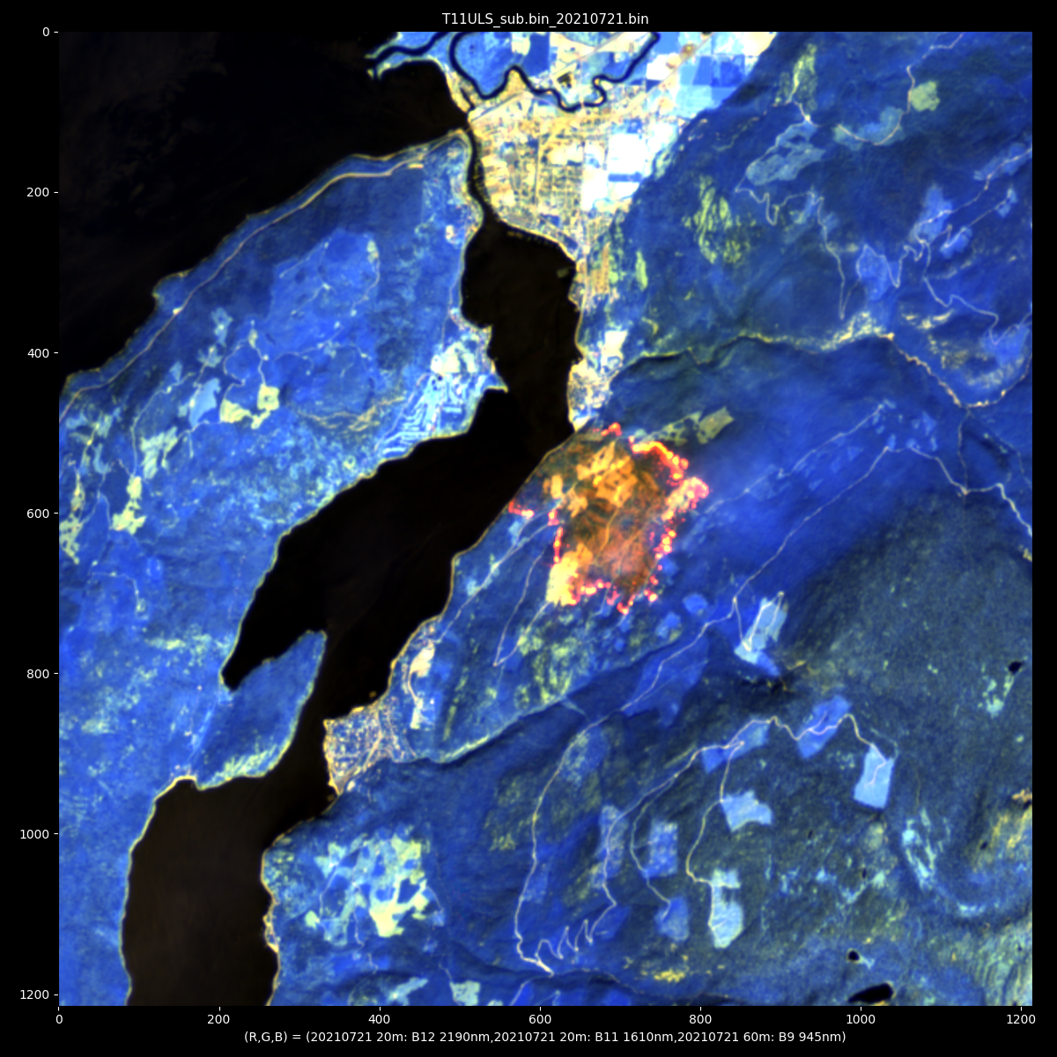
Small fire example RGB = RGB (visible) RGB= (B12, B11, B9) shortwave IR

Slide 9
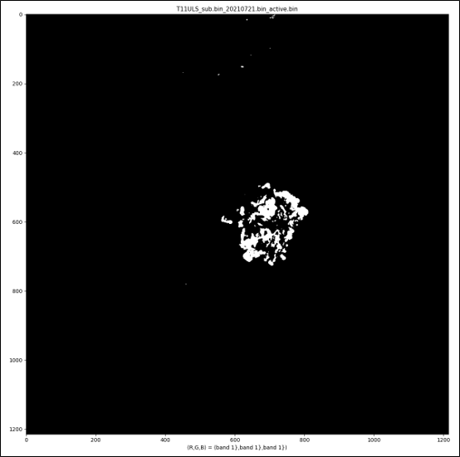
1. Threshold
[please click here for source code]

Slide 10
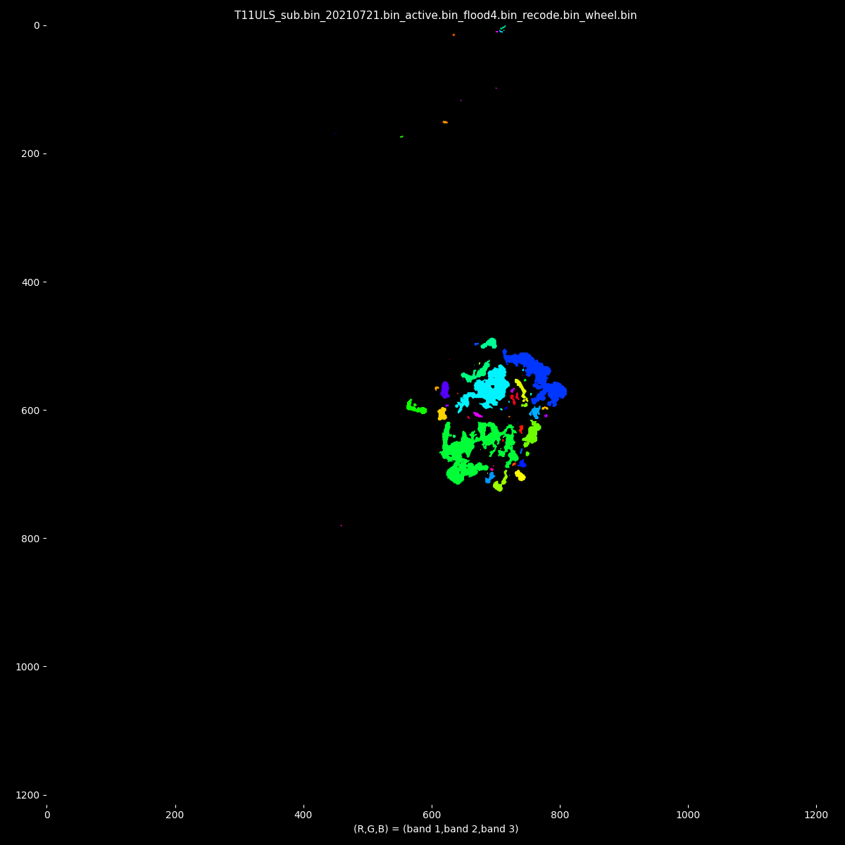
2. Flood fill
[please click here for source code]

Slide 11
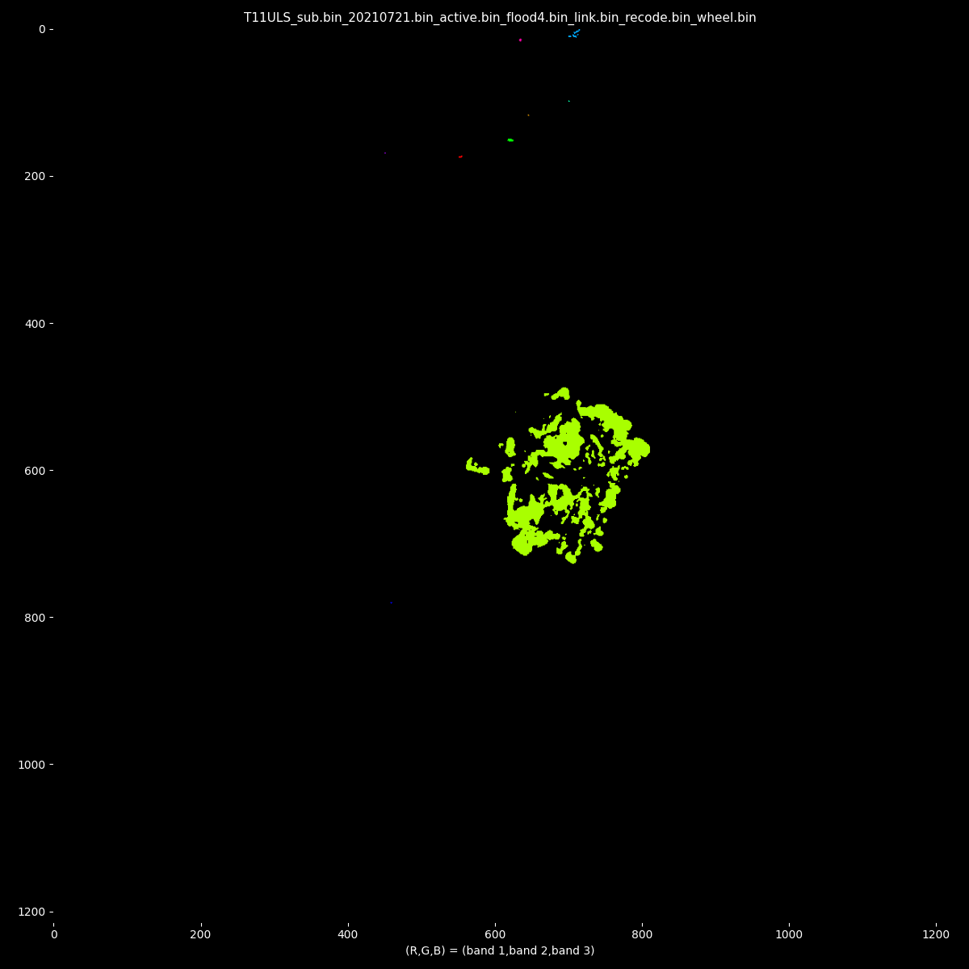
3. Link
[please click here for source code]

Slide 12
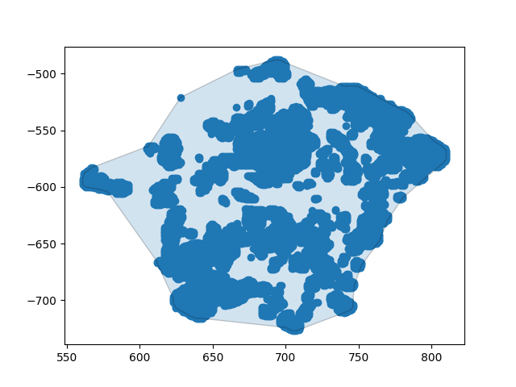
4. Trace
[please click here for source code]

Slide 13
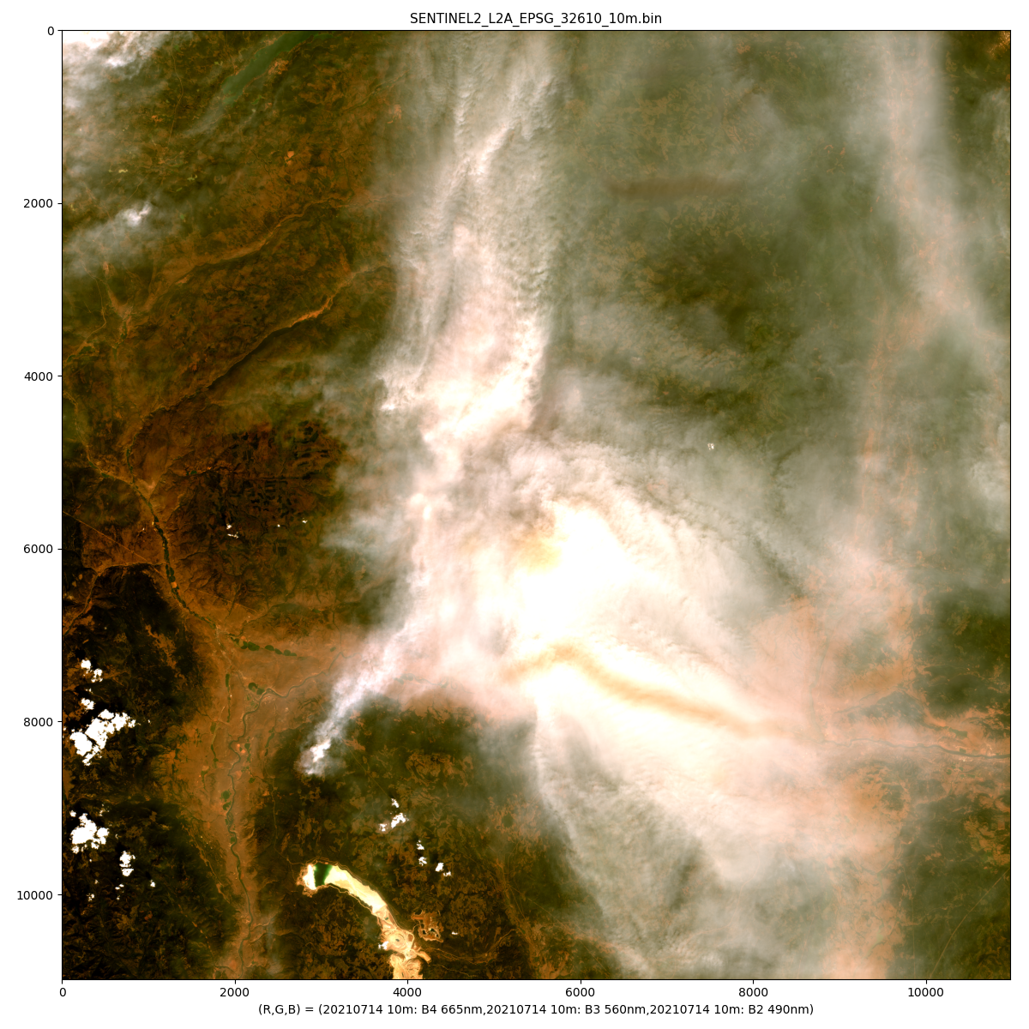
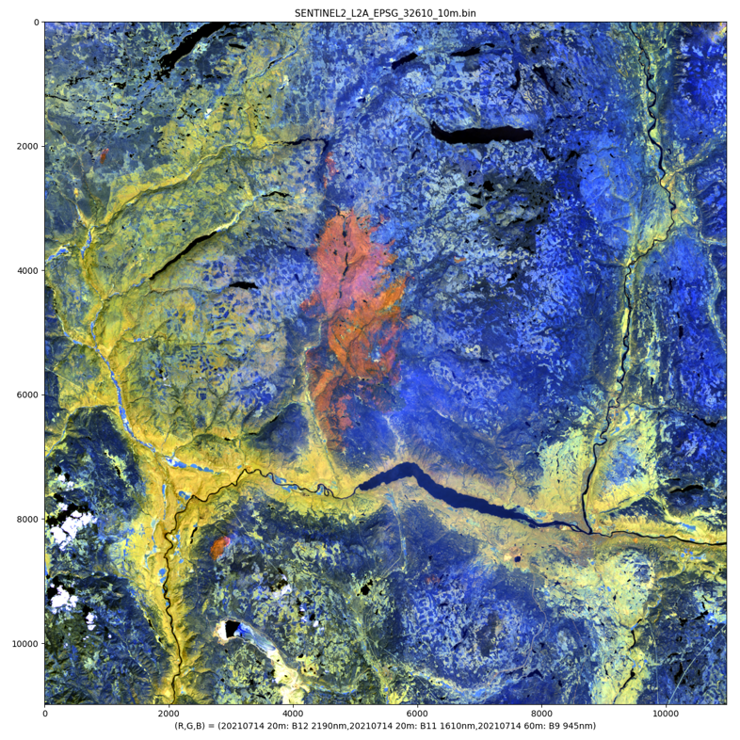
Big fire example RGB = RGB (visible) RGB= (B12, B11, B9) shortwave IR

Slide 14
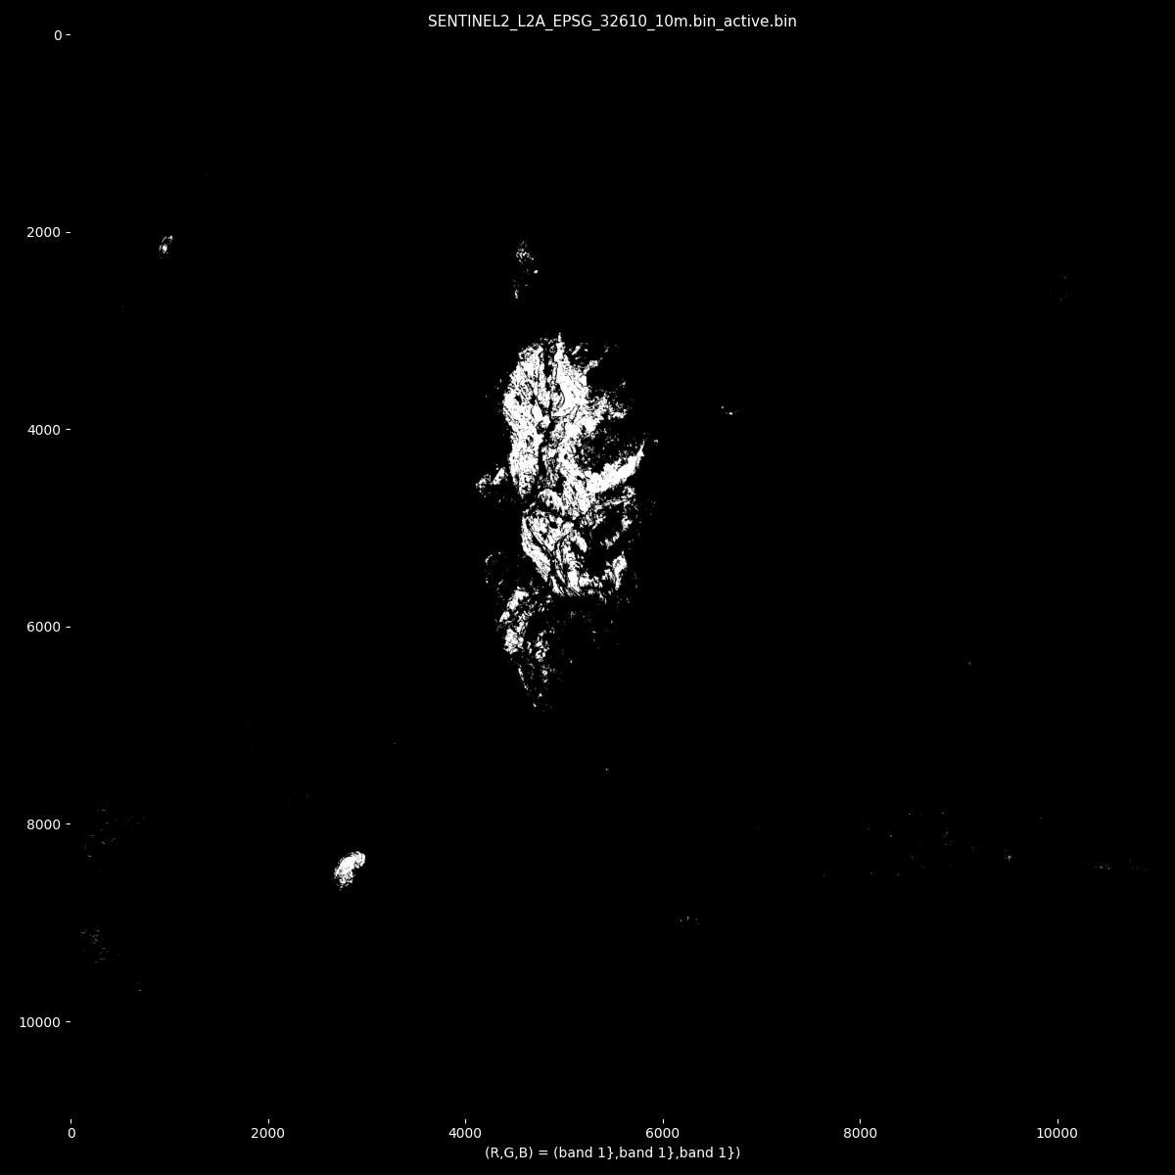
1. Threshold

Slide 15
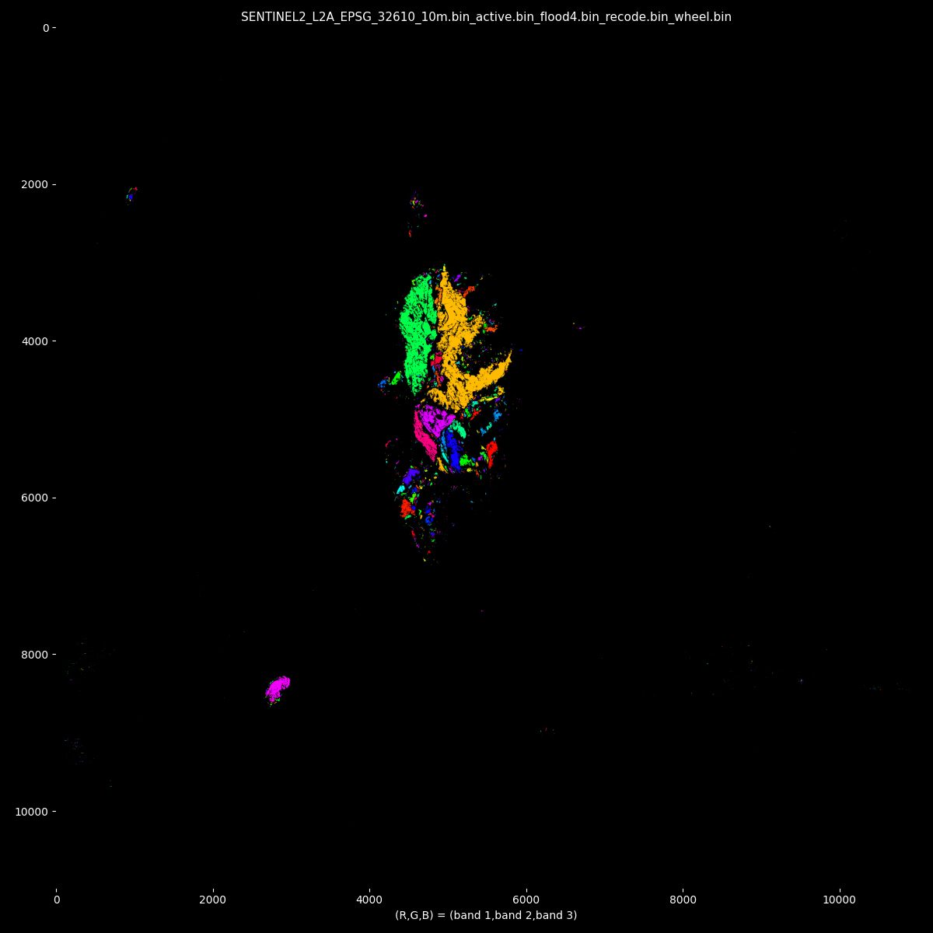
2. Flood fill

Slide 16
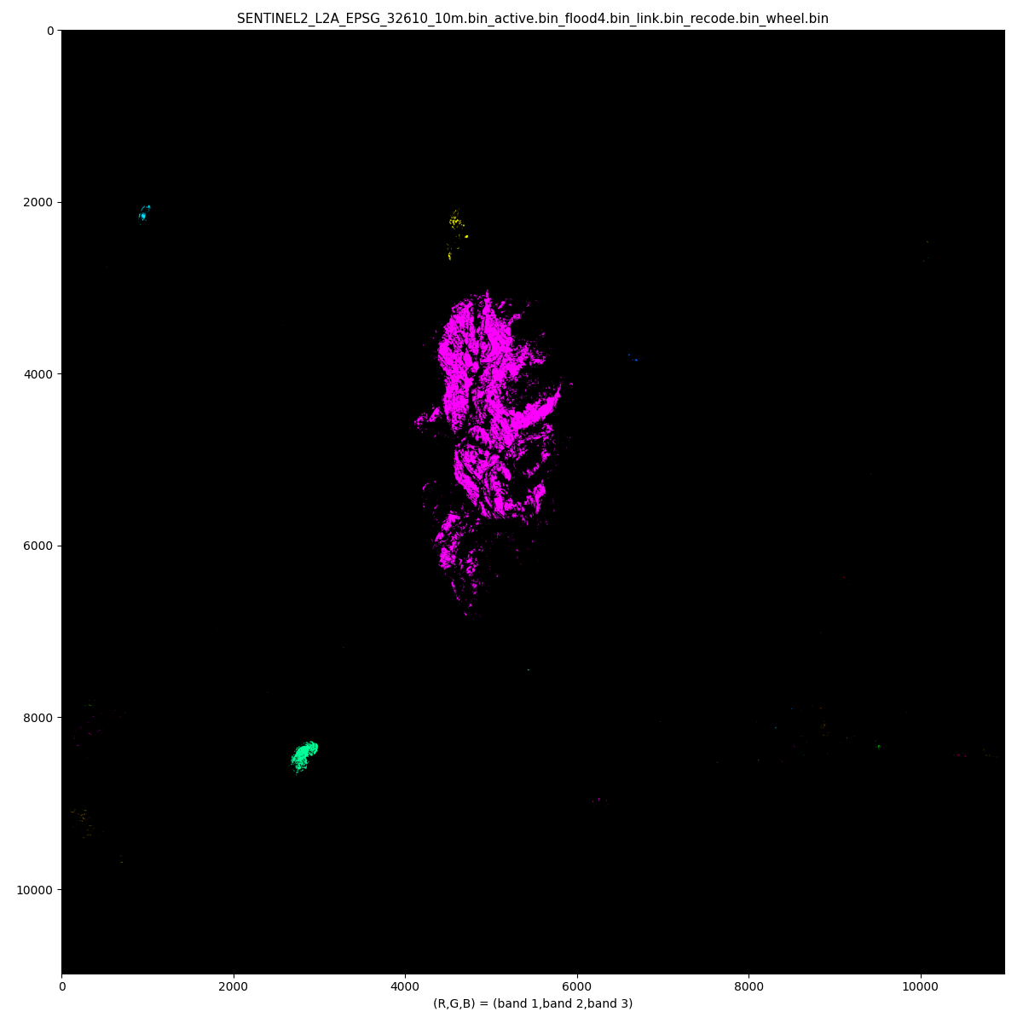
3. Link

Slide 17
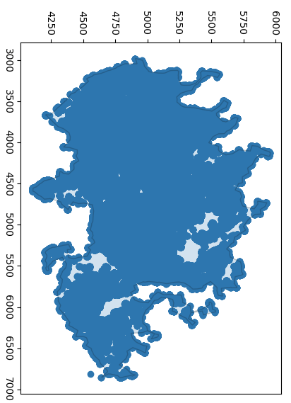
4. Trace
Manually select cluster
Or scrub unwanted areas

Slide 18
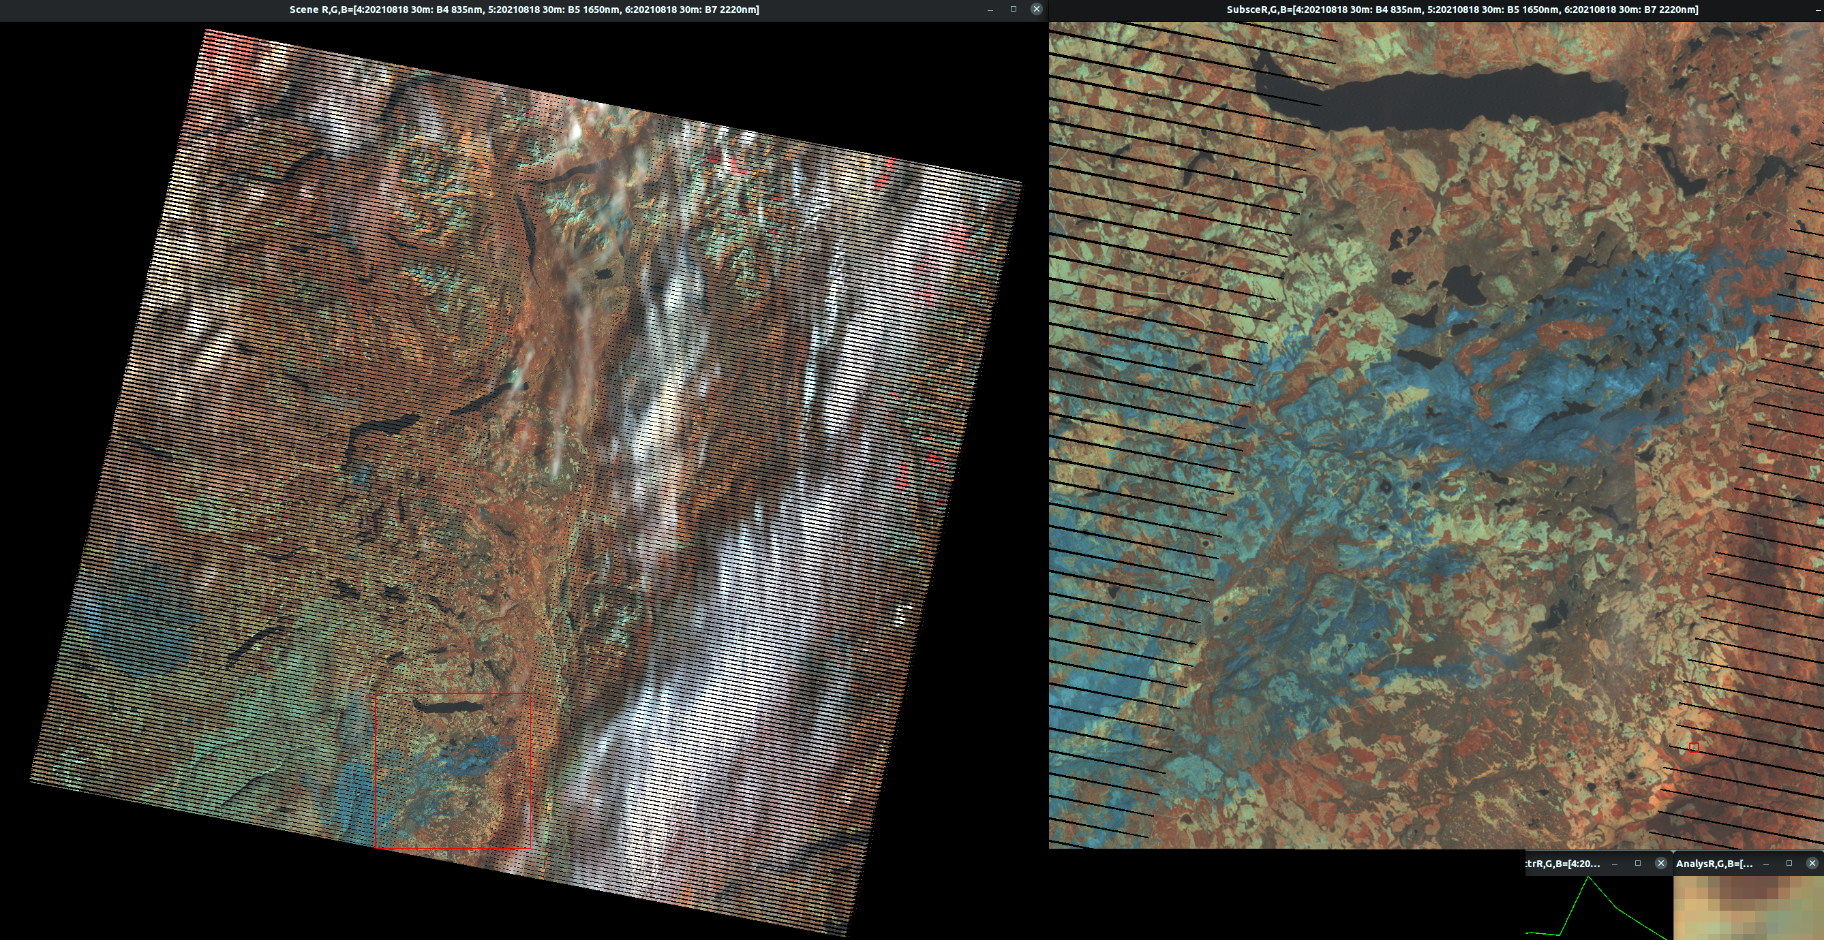
Beware the L7
Sacrelige

Slide 19
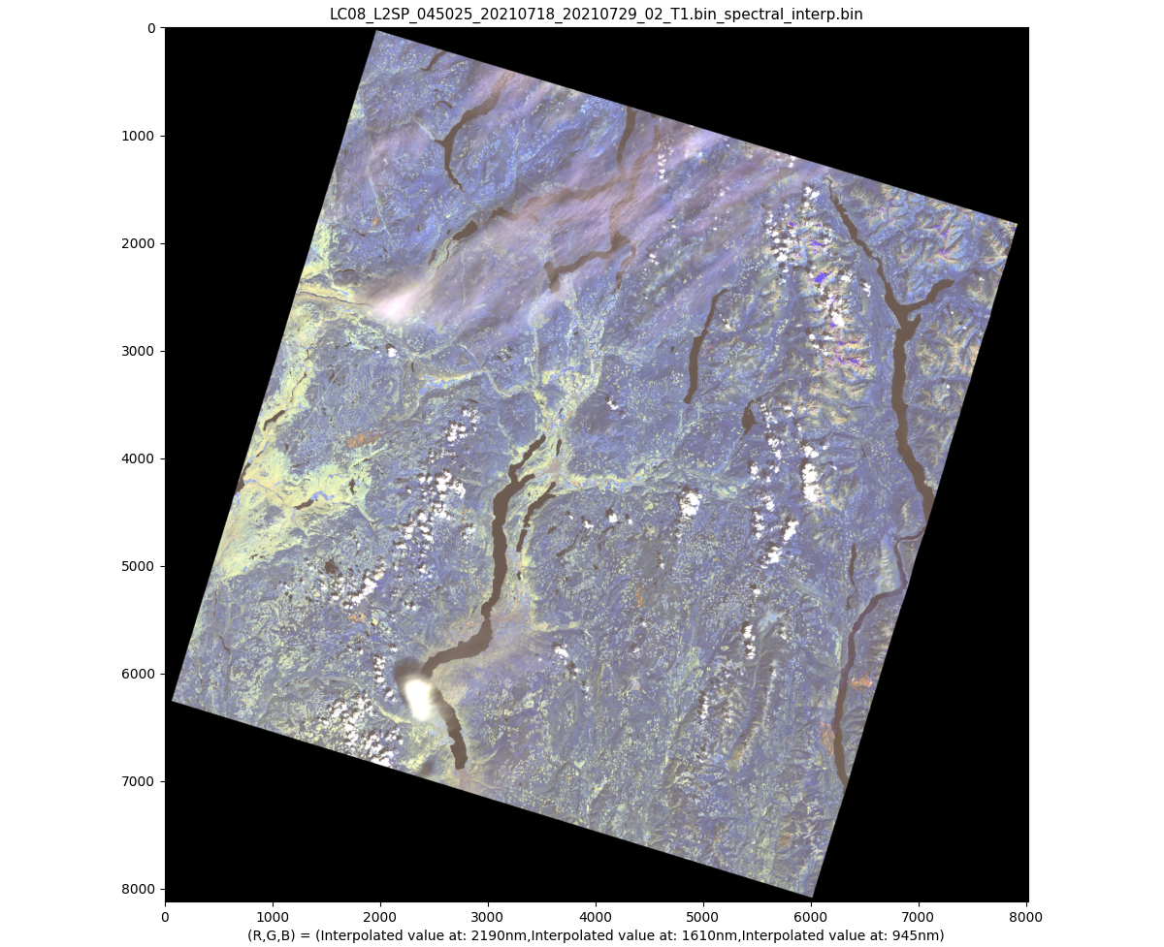
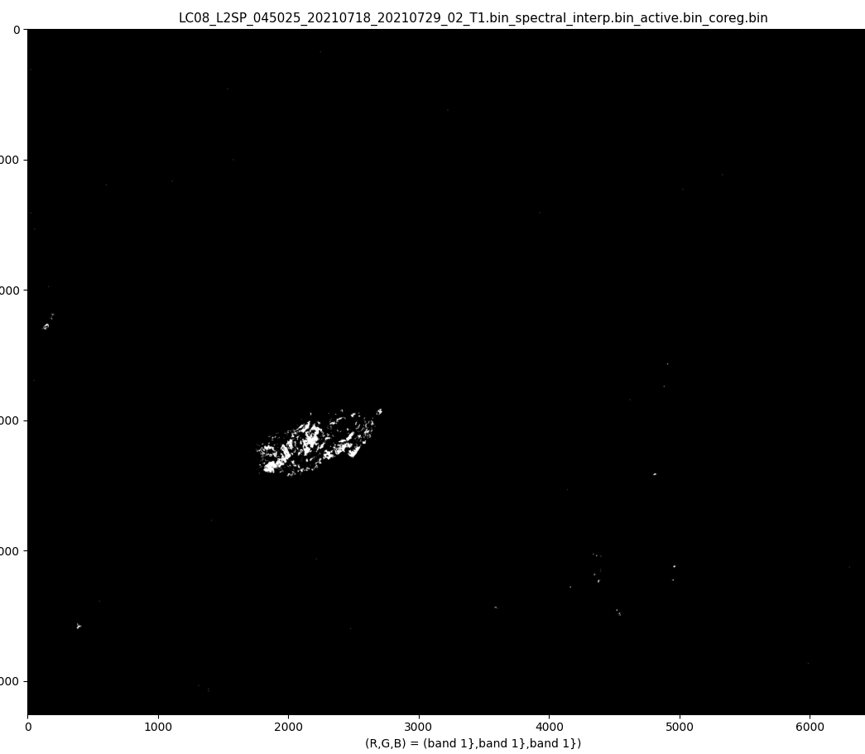
Beware the L8

Slide 20
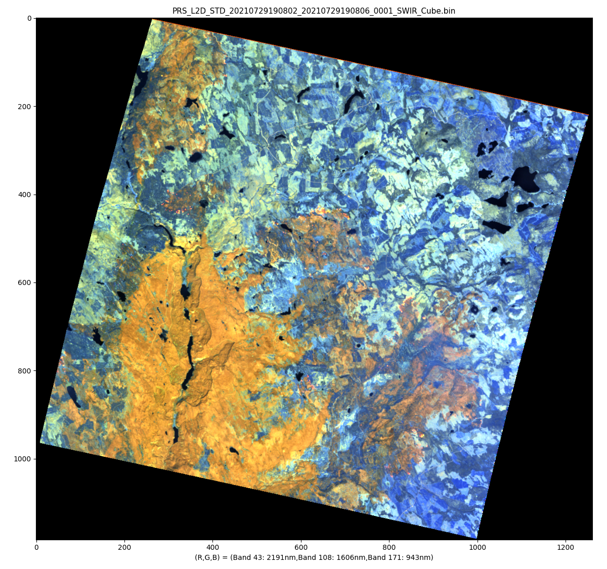
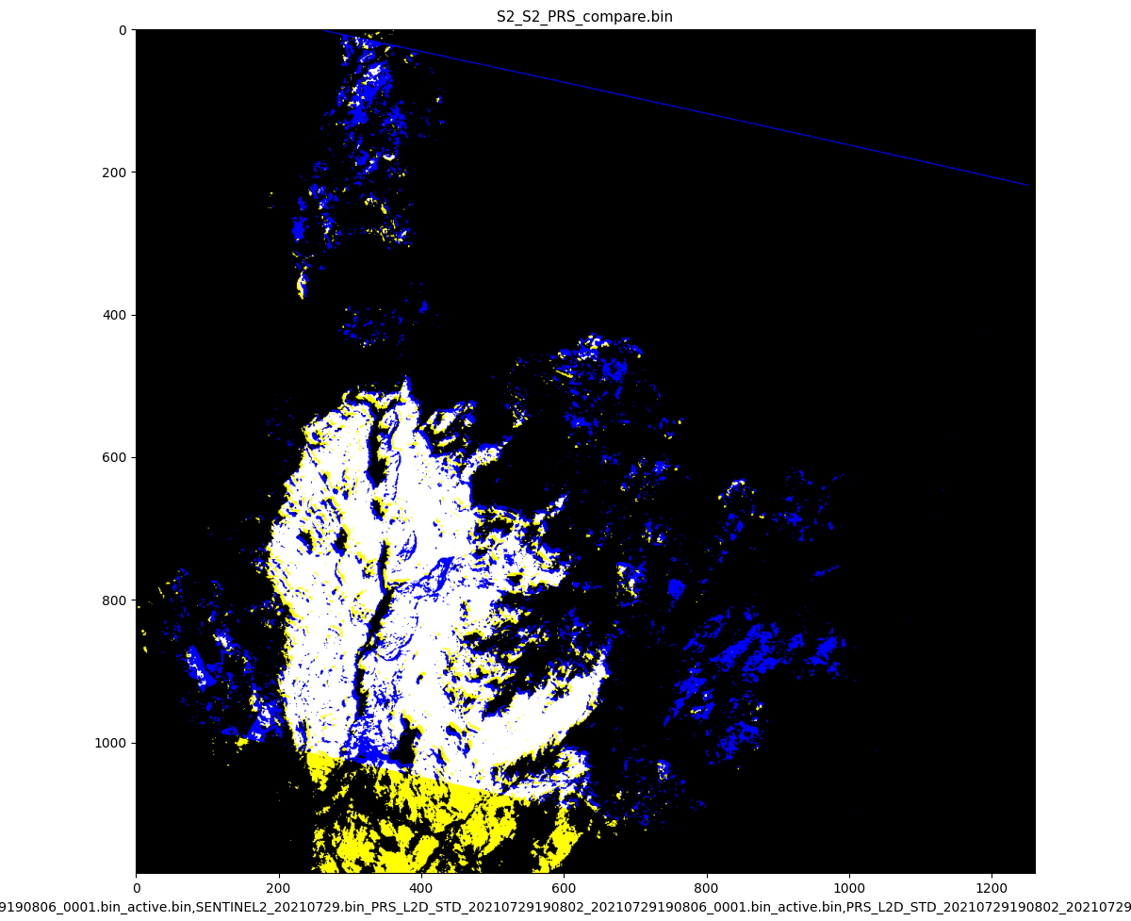
Prisma (ASI). SpecInterp to S2, apply Method #1 and compare w S2:

Slide 21
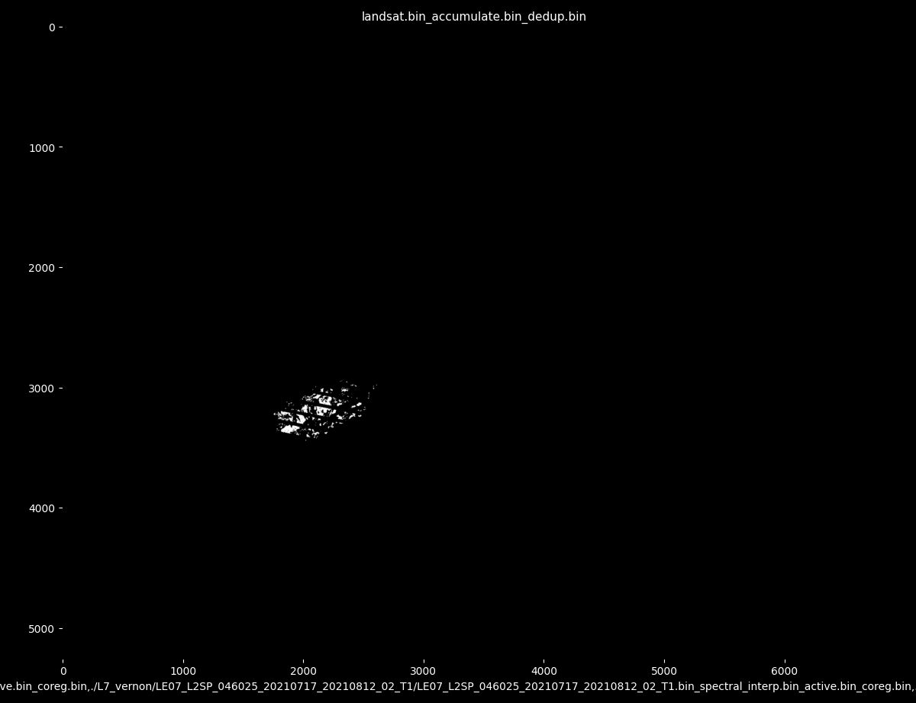
White Rock Lake Fire L7/8 included

Slide 22
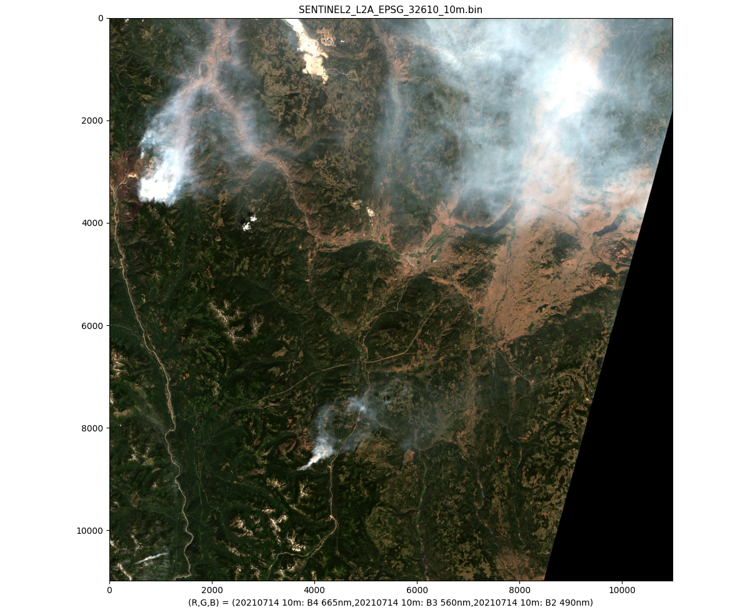
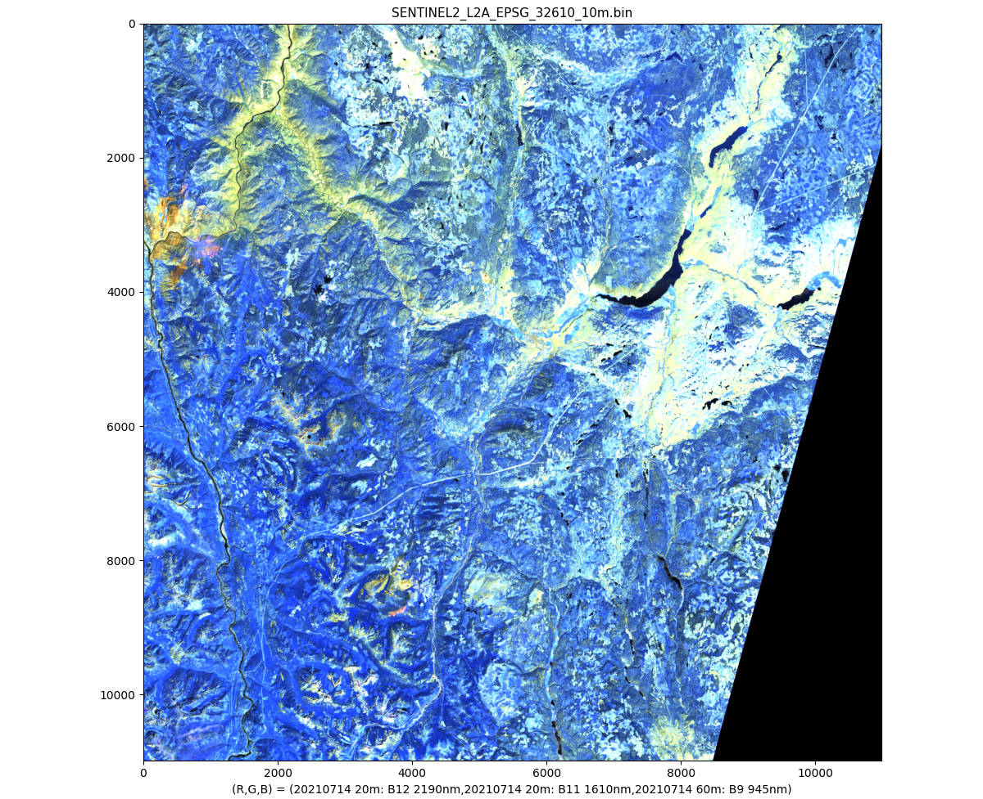
Method 2: dominant band

Slide 23
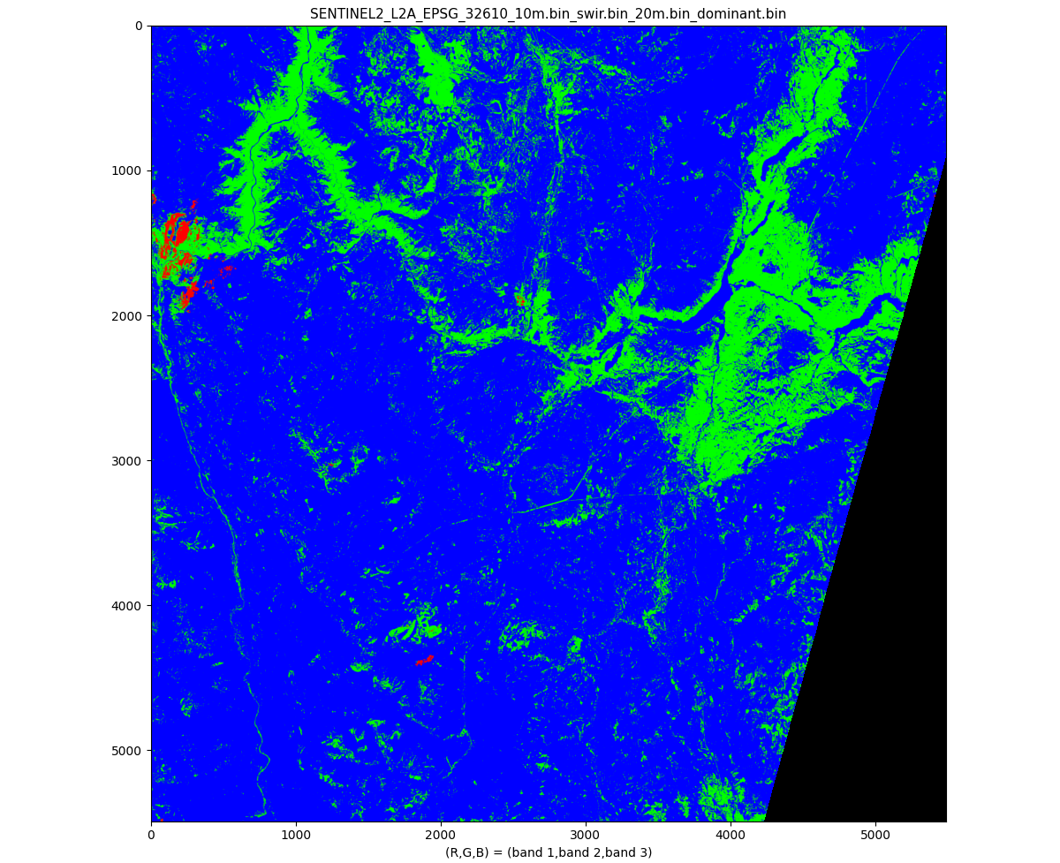
Method 2: dominant band

Slide 24
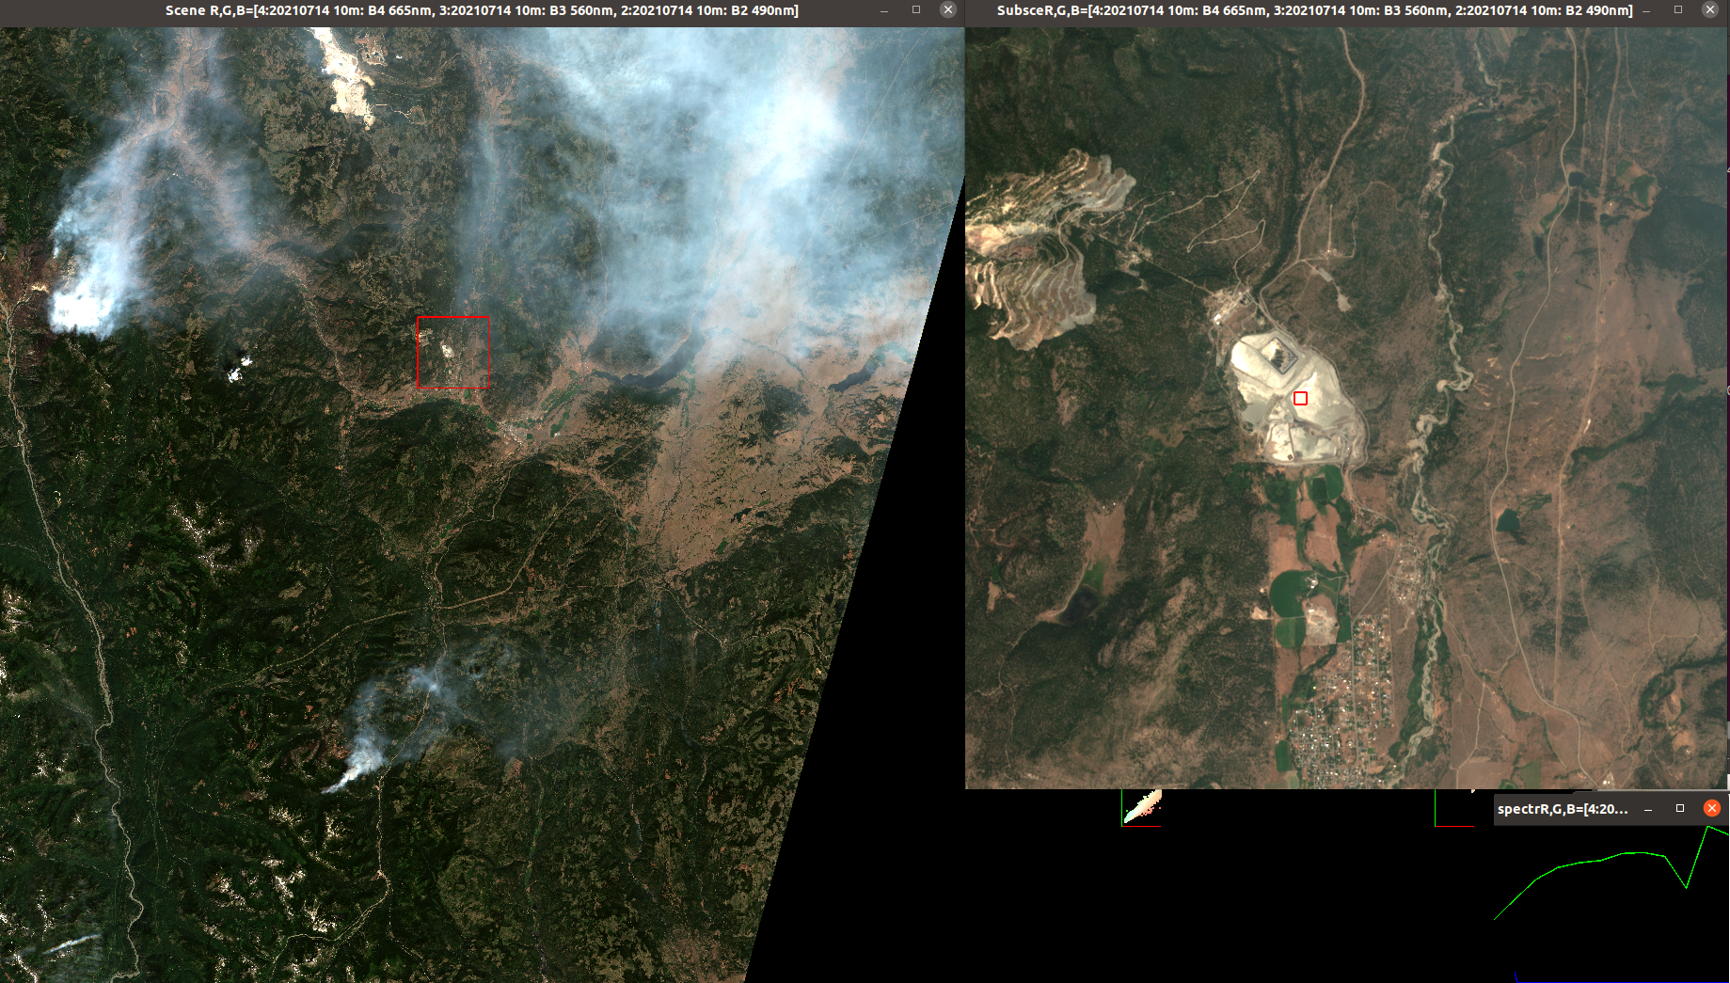
"Better method"
False positive: urban target

Slide 25
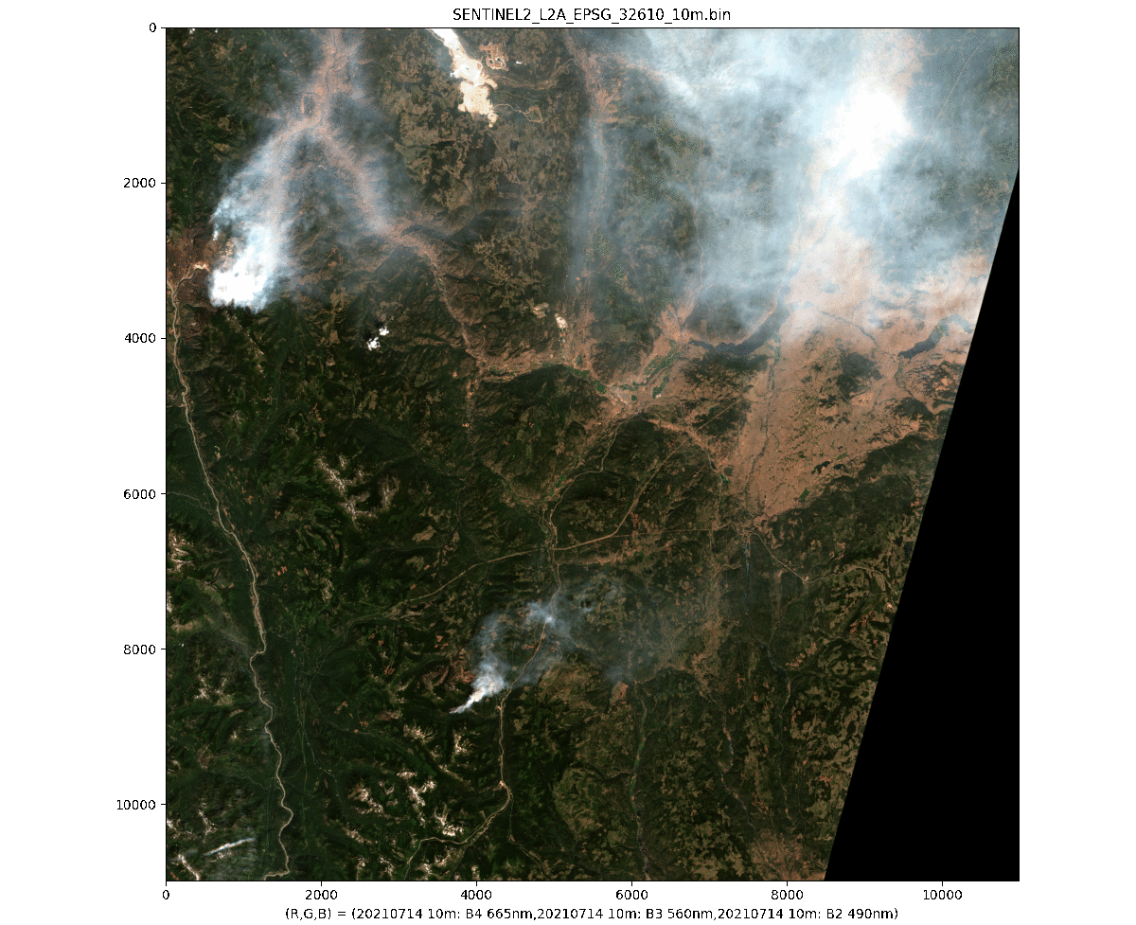
Can we use L2 class map?
From Sen2Cor (ESA)
Results don't look great!
Check snow class (value 11)
Smoke gets marked as snow
Need ML for more reliable/ Contextual land cover
ML can respond to new training and compensate for lack of calibration

Slide 26
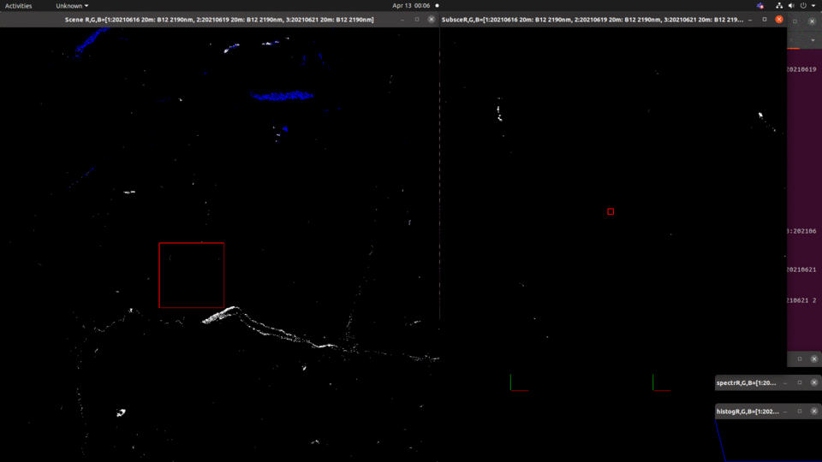
Method 2: dominant band

Slide 27
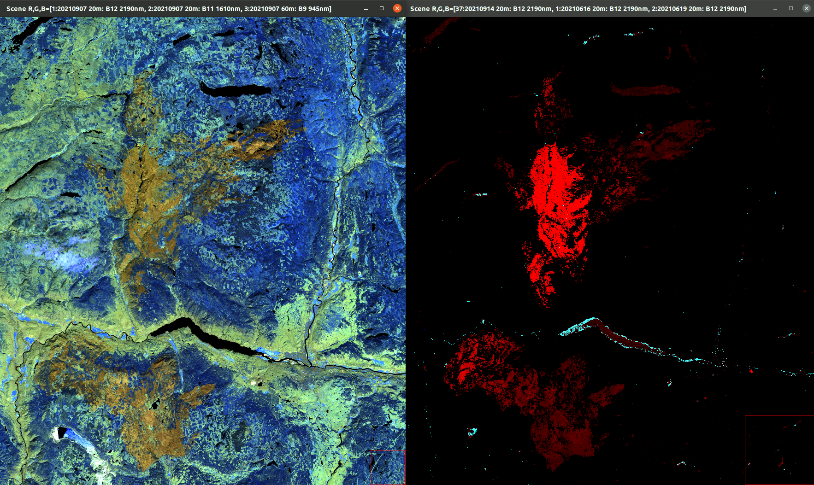
Method 2: dominant band
Dana!

Slide 28
Next steps?
Accessible stepping stone towards actual Machine Learning
Work w Devona & team to meet BCWS standards
Work w Ben & Neal to support fire simulations
Automate addition of Landsat 7/8/9
Remove nonveg/urban/water
Recency of detection
Work w Agile team
More satellites
Possibilities:
Combine immediate info with before/after info
First-principles physics modelling to derive spectra

Slide 29
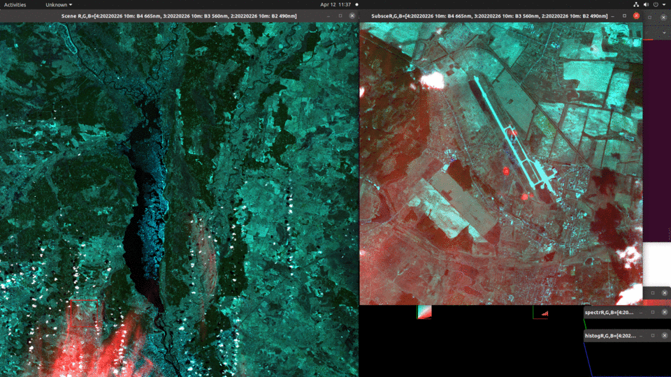
L1 Sentinel-2.. Sen2Cor not applied GML (аеропорт Гостомель)

Slide 30
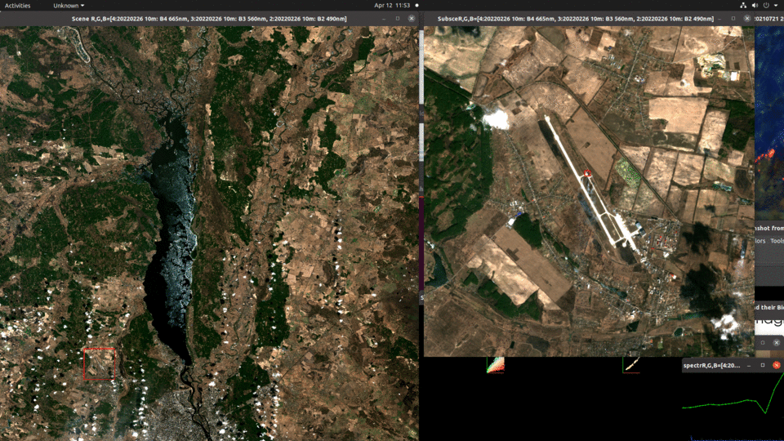
L2 Sentinel-2.. Sen2Cor applied GML (аеропорт Гостомель)

Slide 31
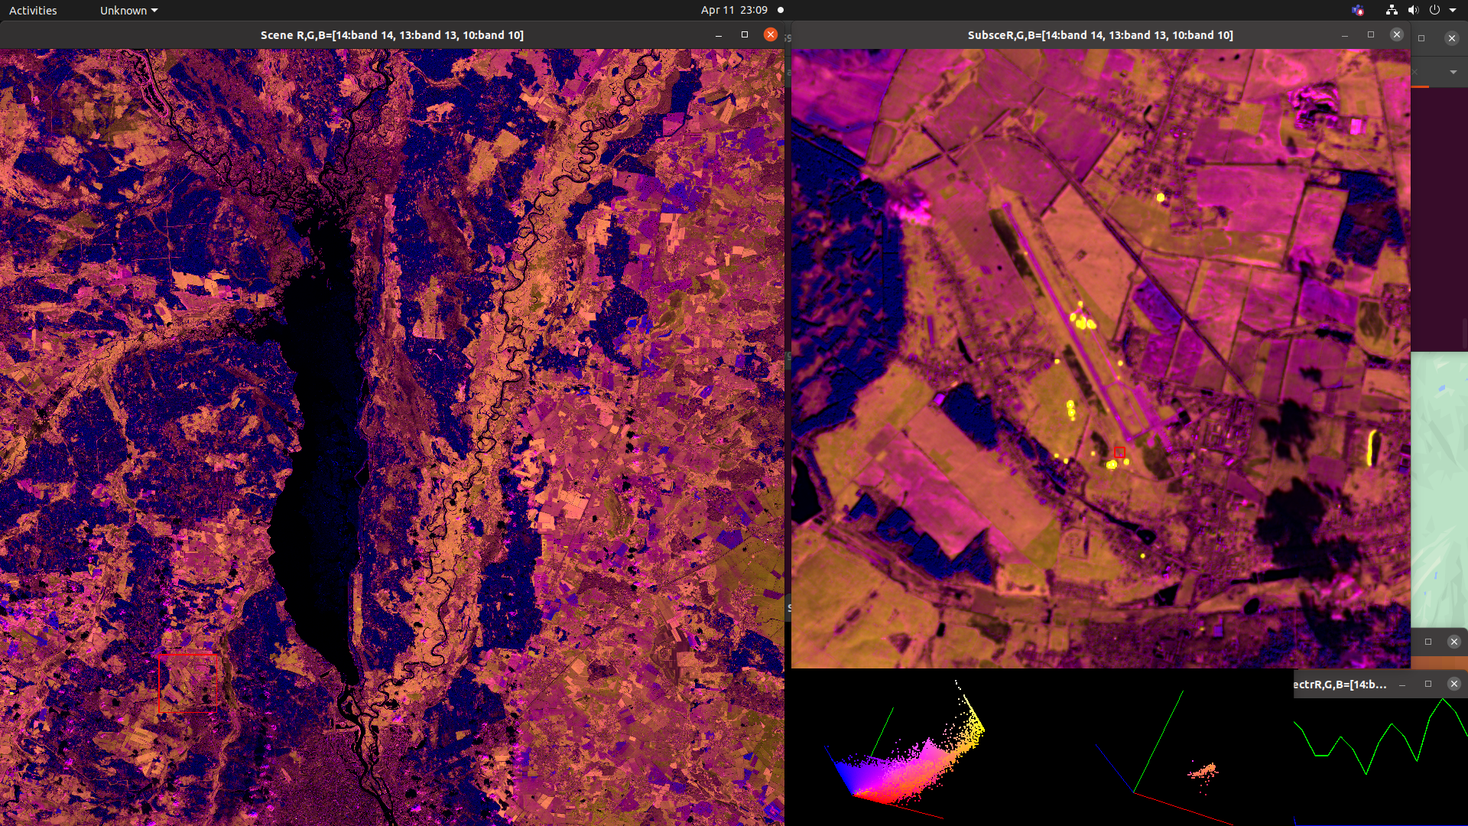
Possibilities
1) Subselect SWIR from L1 (4 bands)
2) perform combinatorial differencing
ENVI samples = 10980 lines = 10980 bands = 4 header offset = 0 file type = ENVI Standard data type = 4 interleave = bsq byte order = 0 band names = {20220226 60m: B9 945nm, 20220226 60m: B10 1375nm, 20220226 20m: B11 1610nm, 20220226 20m: B12 2190nm}
"swir.hdr" 13L, 251C Then raster_sub_compare.cpp

